Slide 1
The Need for Speed: Does horsepower or vehicle weight matter?
Kai Bartlette

Slide 2
Horsepower
Yes, quarter miles times drop with an increase in horsepower - they are simply more powerful and moving faster. This model explains about half the reason why, with an R squared value of 48.5%. There is a negative correlation, which the best fit line illustrates.

Slide 3
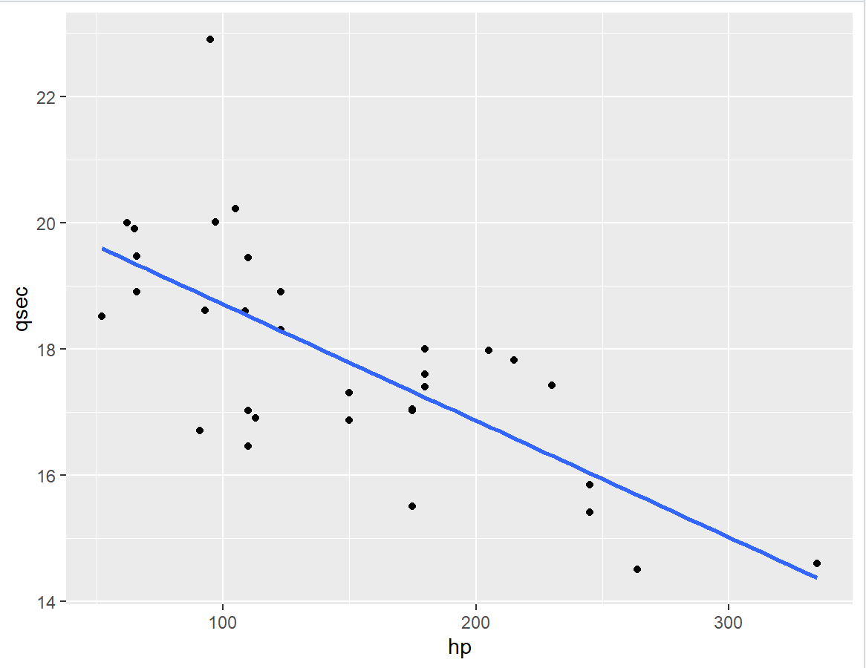
Scatter Plot for Quarter Mile Time by Horsepower

Slide 4
Vehicle Weight
However, for vehicle weight, there was an extremely small R squared value.
Judging by the graphical model and this very small r-squared value, the weight of the vehicle doesn’t account for any of the variance in quarter mile time.

Slide 5
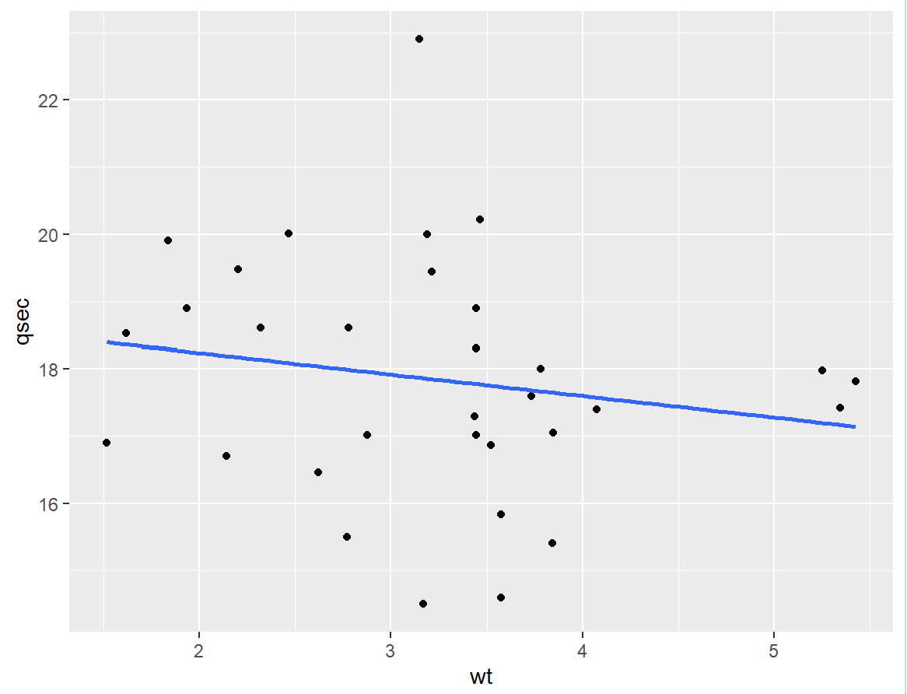
Scatter Plot for Quarter Mile Time by Vehicle Weight

Slide 6
Thank you!
Kai Bartlette

